Slide 1

INTELLIQUIZ
TAKSH BOHRA(18BIT0296)
YATHARTH GOURI(18BIT0315)
HARSHIT KHERA(18BIT0371)
KRITIKA GARG(18BIT0427)

Slide 2
ABSTRACT
The ONLINE QUIZ AND CONTEST MANAGEMENT SYSTEM is a web application to take online quiz in an efficient manner with no wasting of time for checking the paper.Teachers give papers to students according to their convenience and time and there is no need of using extra things like paper, pen etc. This can be used in educational institutions as well as in corporate world. There is no restriction that examiner has to be present when the candidate takes the test. This Web Application provides facility to conduct online examination worldwide. It is automatically generated by the server. Administrator has a privilege to create, modify and delete account for teachers. The main objective of ONLINE QUIZ AND CONTEST MANAGEMENT SYSTEM is to efficiently evaluate the candidate thoroughly through a fully automated system that not only saves lot of time but also gives fast results.It saves time as it allows number of students to give the exam at a time and displays the results as the test gets over, so no need to wait for the result.

Slide 3
What are we expecting to achieve in this project
The Main Objective of Online Quiz is User-friendly systems are not only needed for the creator, but also for participants. A responsive design is an approach where the web designer wants to reach an optimal web experience for a wide range of devices. Multiple choice is the options you can use with our online Quiz system. Having more than one option is necessary to check several types of knowledge. Auto quiz publish, login with username and password. Automatically check answers and give the result to the students.

Slide 4
PROBLEM STATEMENT
As currently whole world is suffering from COVID-19 outbreak so we decided to built an application that will help teachers as well as students during these times. QUIZ SYSTEM is a software developed especially taking the pandemic situation into consideration as most of the educational institutions are conducting online classes so this application help teachers in easy evaluation and also monitor each students progress. Teachers can assign the quiz to students after every class to know if the students are able to understand or not in the virtual classes. Quiz System is accessed by entering the username and e-mail id which is added to the database. If the answer is correct, score is incremented and there can be negative marks for wrong answers. Final score will be displayed and updated in the database with username.

Slide 5
INTRODUCTION
Online Quiz are an important method of evaluating the success potential of students. This research effort the individuals under consideration were students who would be enrolling in computer courses or Technologies Registrations. A prototype of a web-based placement Quiz system is described from the standpoint of the research effort, end user, and software development. Class Marker’s secure, professional web-based Quiz maker is an easy-to-use, customizable online testing solution for business, training & educational assessment with Test & Quizzes graded instantly saving your hours of paperwork.

Slide 6
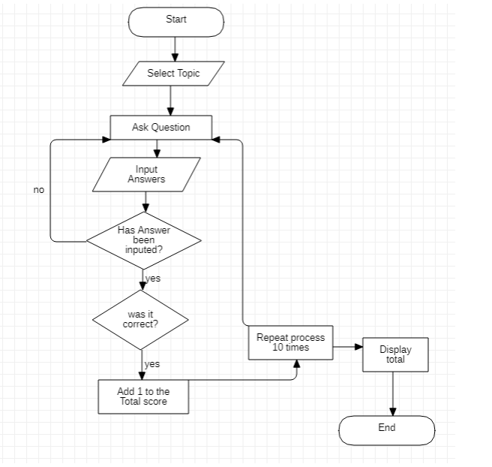
PROCESS FLOW DIAGRAM

Slide 7
MODULES
This project involves following phases
After Administrator Login
Add Quiz
Users
Remove Quiz
Ranking

Slide 8
MODULES
This project involves following phases
After Students Login
Topic
Total Marks
History
Ranking

Slide 9
ADMINISTRATOR
AUTHENTICATION PHASE:
This proposed system is completely authenticated in order to enhance security and corruptions of database as well as the software. A person is given access permission to this system when he/she has got a valid username and password i.e. the administrator. Hence this authentication module includes two fields where administrator (programmer) is asked to enter the username and password. The details include:
1. Username
2. Password

Slide 10
REGISTRATION PHASE:
If an existing user then he can enter into the system, using his valid username and password.
If the participant is a new one then he has to fill the registration form. Now valid username and password will assign to the user. Using that he can enter into the system.
VIEW RANK:
This phase contains the administrator or the teachers to view the ranks of the students.
DELETE USER:
This phase contains the administrator or the teachers to delete the users if anyone tries to create fake profile or do malpractice.

Slide 11
QUESTION GENERATION PHASE:
This phase includes the various categorized question generation. In this phase the administrator can perform add, modify, delete, move_next, move_previous, clear_all operation. This phase may be the most important phase in proposed system, because it is the one where the entire system gets the categorized question.
REPORT GENERATION PHASE:
This phase contains various report generation related to our system such as Administrator report, Participant report, Rank etc. the report gives the overall view about our system.

Slide 12
PARTICIPANT
AUTHENTICATION PHASE:
This proposed system is completely authenticated in order to enhance security and corruptions of database as well as the software. A person is given access permission to this system when he/she has got a valid username and password. Hence this authentication module includes two fields where participant is asked to enter their username and password. The details include:
1. Username
2. Password
REGISTRATION PHASE:
If the participant is an existing user then he can enter into the system, using his valid username and password.
If the participant is a new one then he has to fill the registration form. Now valid username and password will assign to the user. Using that he can enter into the system.

Slide 13
QUESTION BANK PHASE:
This phase provides the students a set of multiple-choice questions and a set of answers below the specific question. Once after the current question has been answered it automatically makes a move to the second question with their corresponding answers.
This module is provided with four fields:
1. Question number
2. Option 1
3. Option 2
4. Option 3
5. Option 4
RESULT GENERATION PHASE:
The result of the corresponding student is generated based on his, her performance in the test. The result is generated at the end of the quiz. The result is generated with the help of following field:
1. Username
2. Category
3. Mark

Slide 14
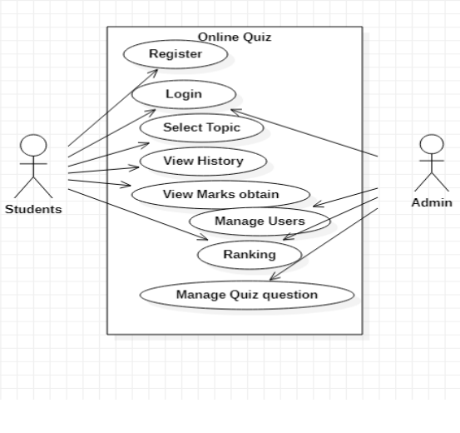
USE CASE DIAGRAM

Slide 15
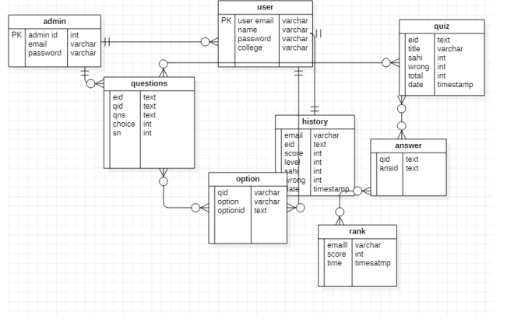
ER DIAGRAM

Slide 16
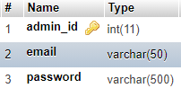
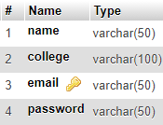
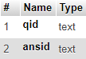
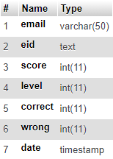
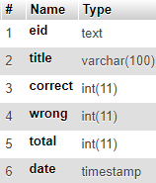
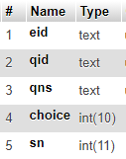
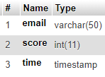
DATABASE
ADMIN USER ANSWER HISTORY
QUIZ QUESTION RANK

Slide 17

HOME PAGE

Slide 18
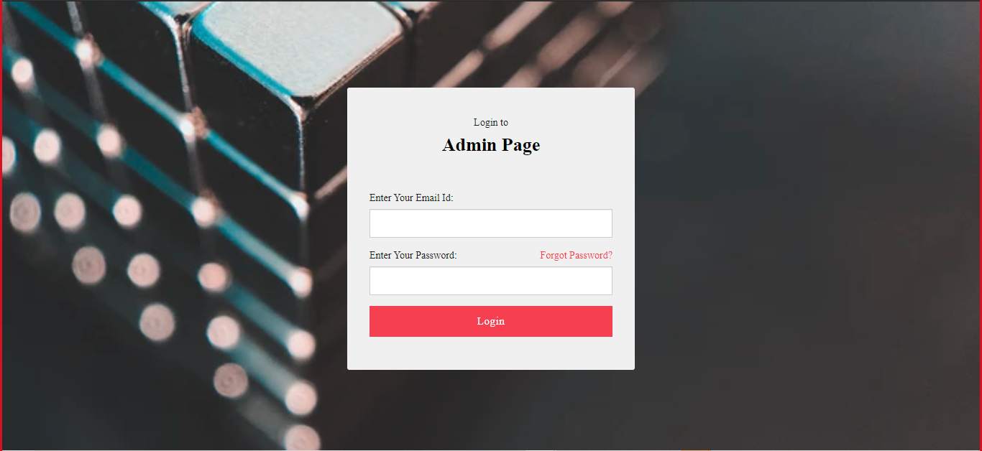
ADMIN PAGE

Slide 19
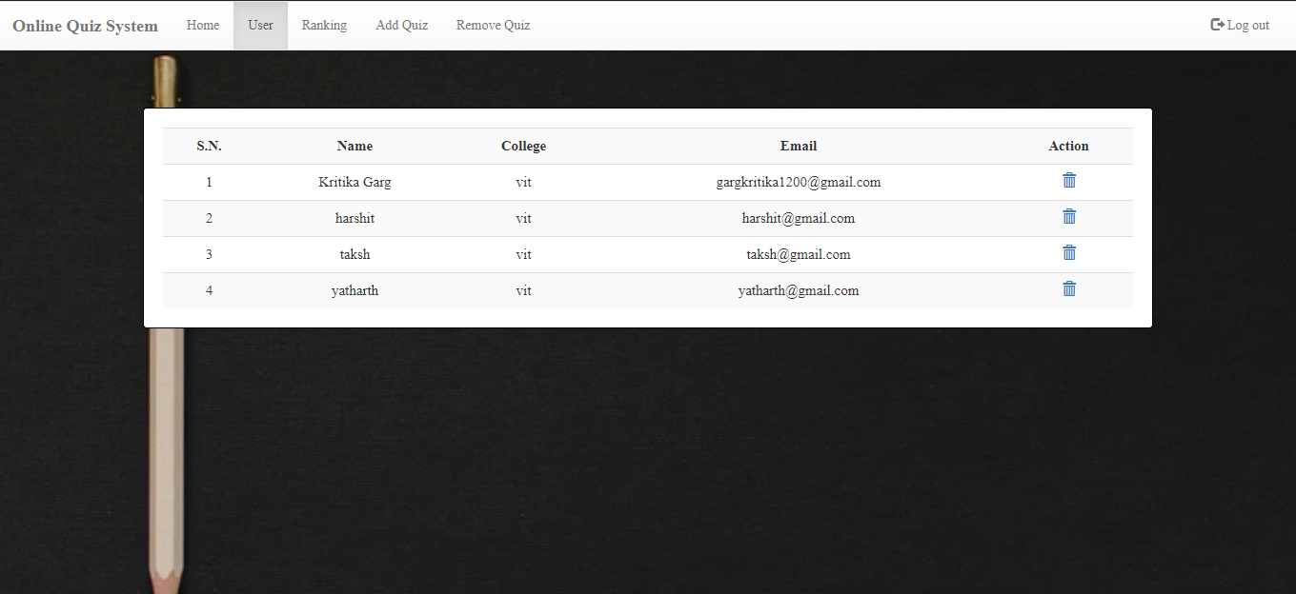

Slide 20
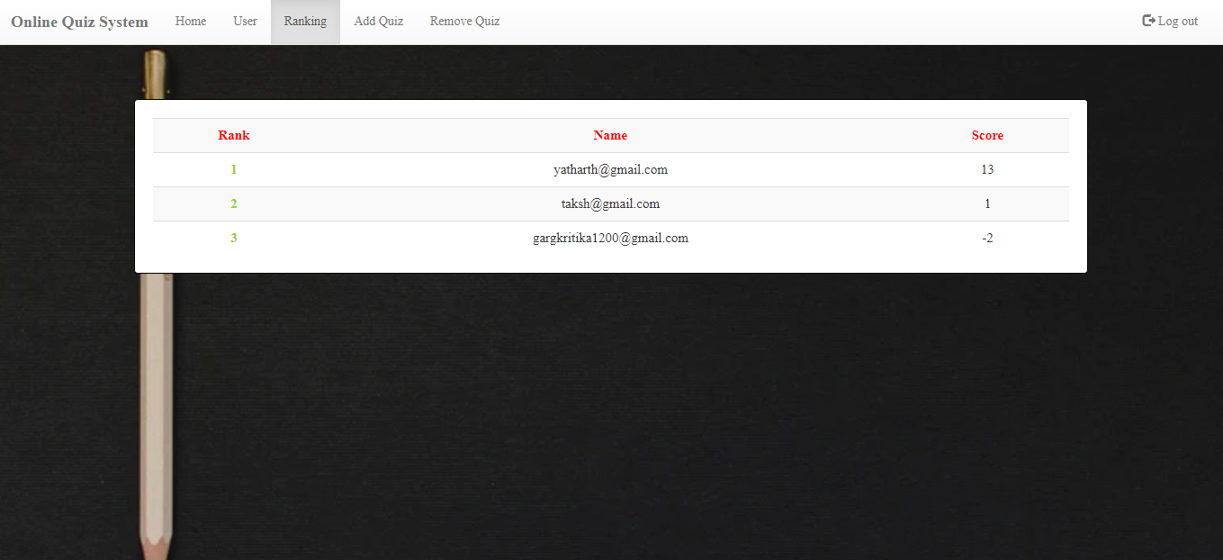

Slide 21
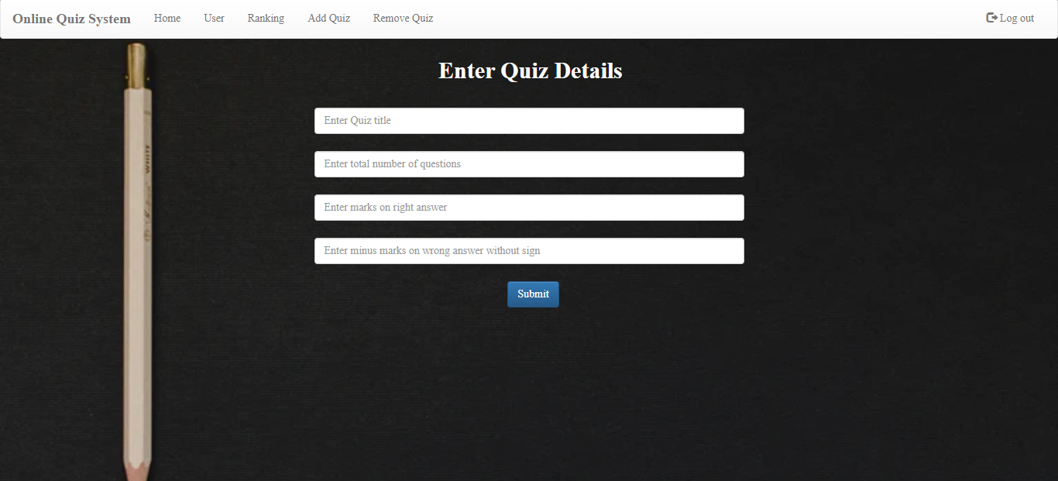

Slide 22
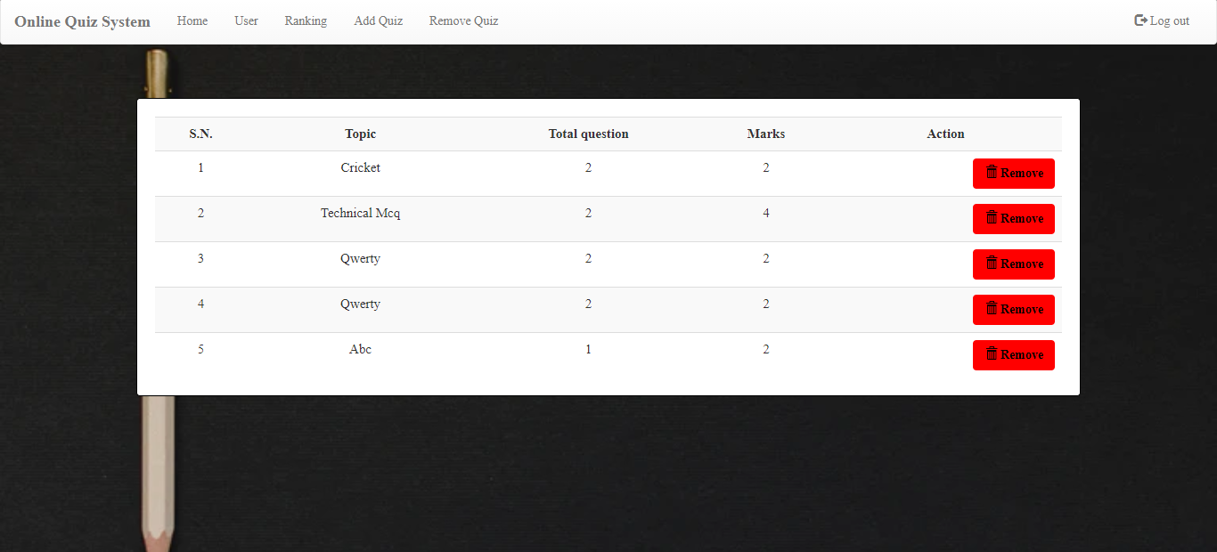

Slide 23
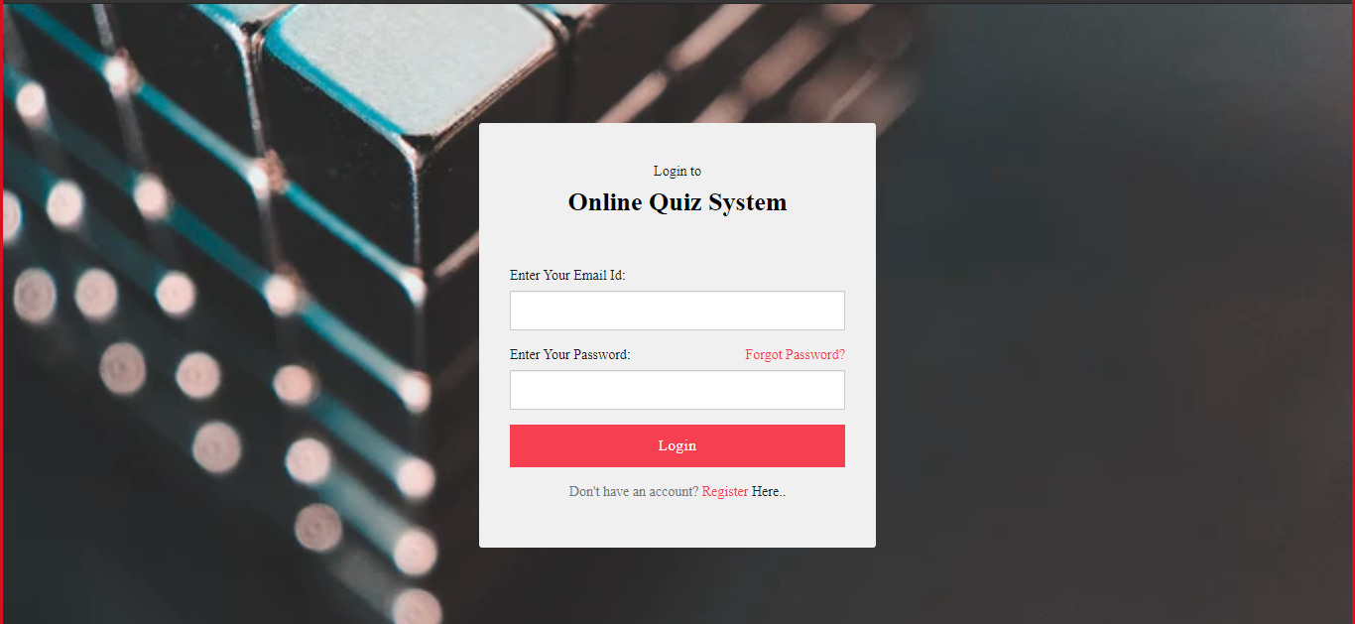
STUDENT PAGE

Slide 24
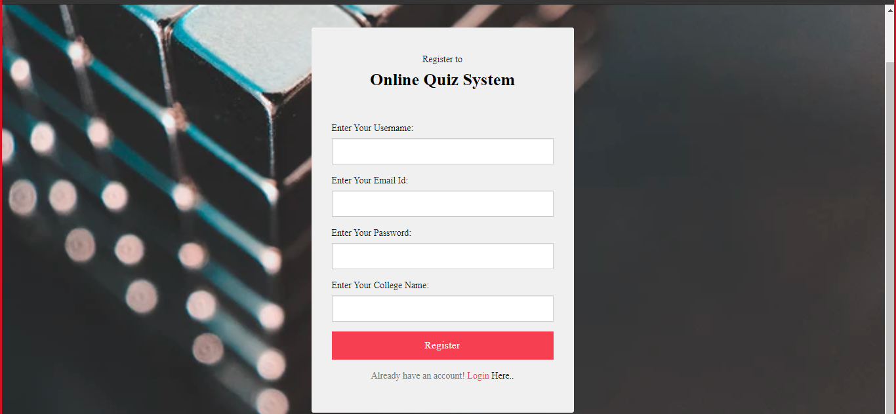
STUDENT PAGE

Slide 25
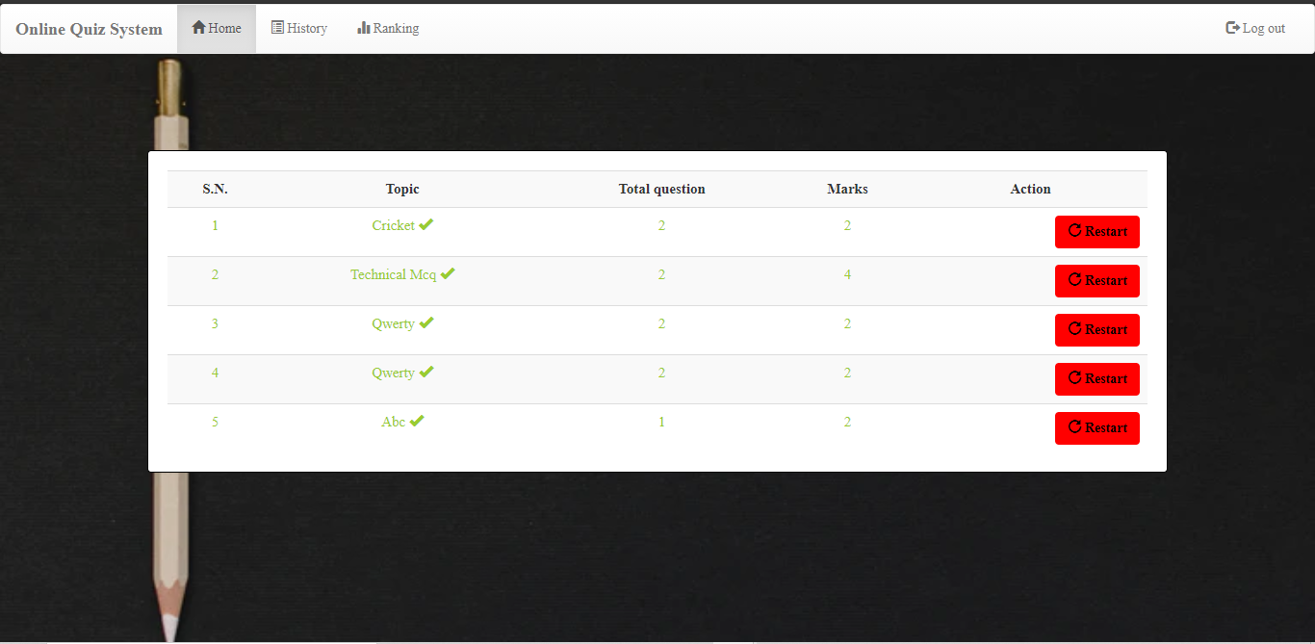

Slide 26
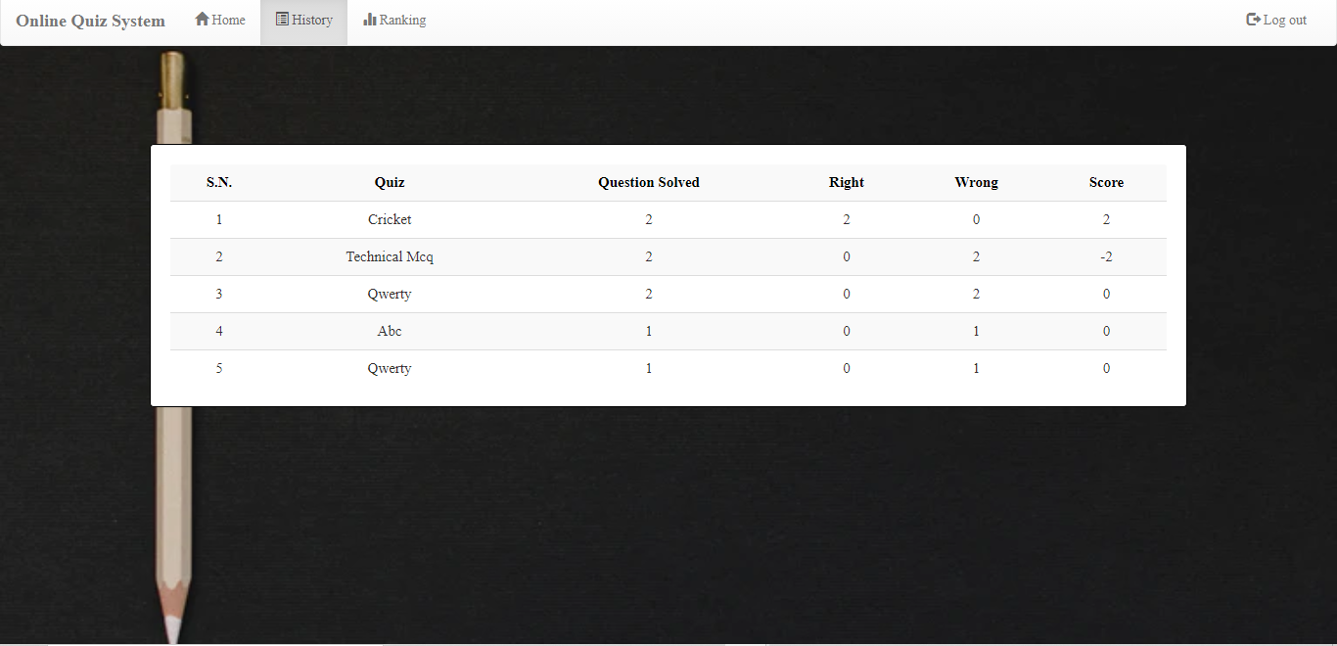

Slide 27
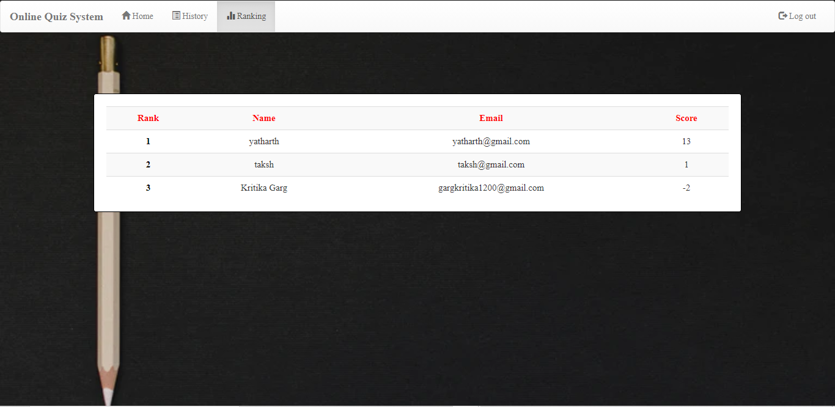

Slide 28
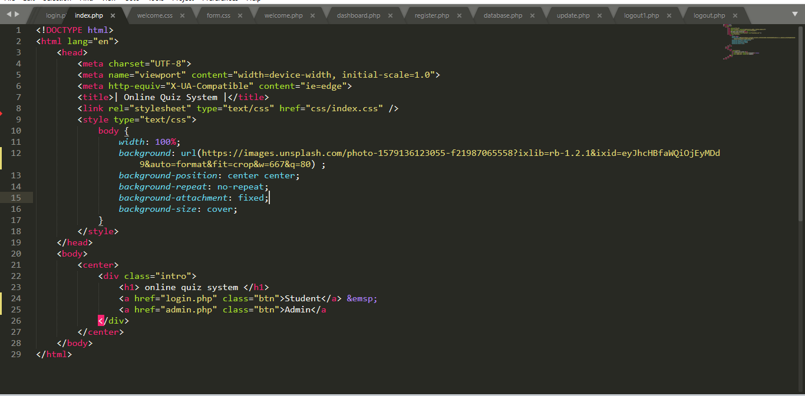
SAMPLE CODE

Slide 29
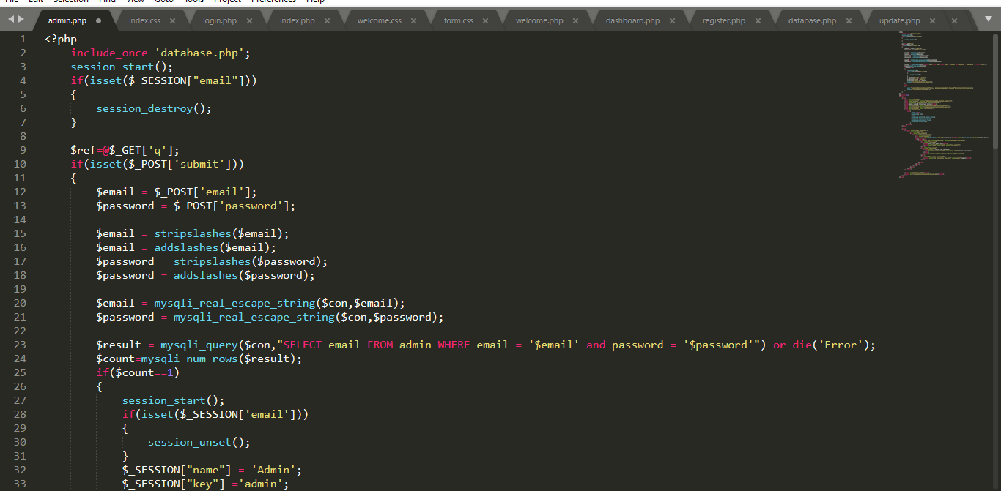

Slide 30
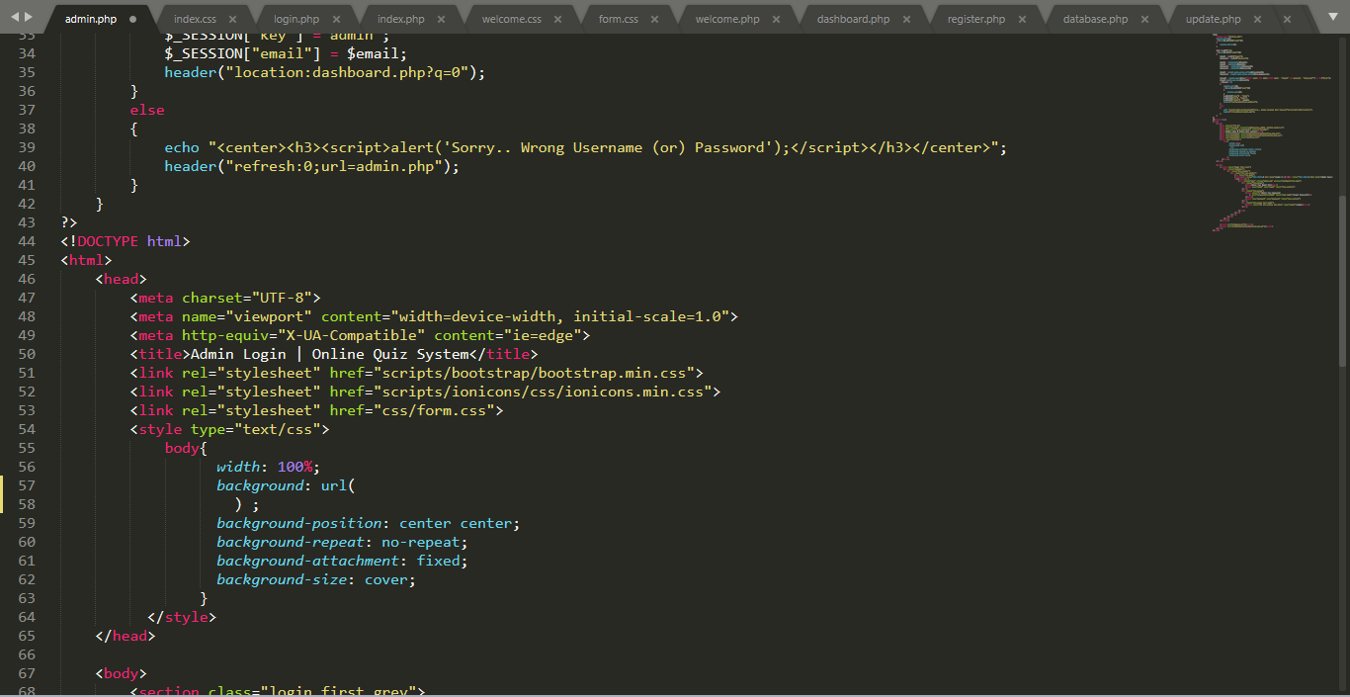

Slide 31
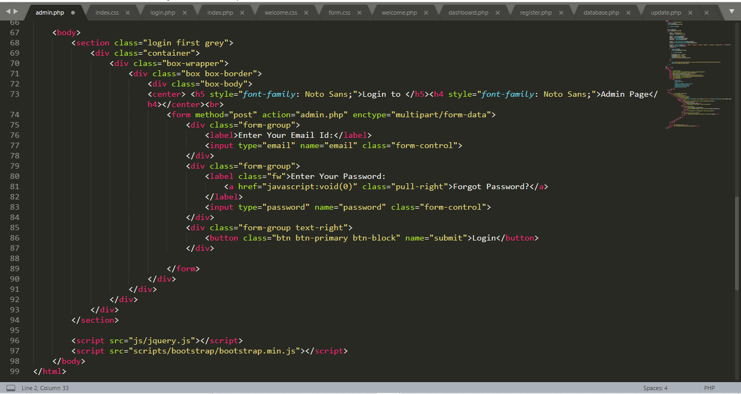

Slide 32
ADVANTAGE OF THIS SYSTEM
Engage audience in a unique and fun way and connect them to brand or learning material. Taking online quizzes makes it possible to have a large number of participants It is significant more easy to randomize your question with just one click than to do it all manually. Another plus of online quizzes is getting immediate results from your participants. Not only does the creator get the results, the participant itself is also possible to get his or her results. There are several ways to gain more brand awareness. It’s possible to show one question at the time with online quizzes. People are not able to skip a question, because you will get a reminder that you can’t leave the answer blank.

Slide 33
CONCLUSION
This online quiz system provides facility to conduct online examination worldwide. It saves time as it allows number of students to give the exam at a time and displays the results as the test gets over, so no need to wait for the result. It is automatically generated by the server. Administrator has a privilege to create, modify and delete the test papers and its particular questions. User can register, login and give the test with his specific id, and can see the results as well.

Slide 34
THANK
YOU

